Slide 1

Organizational Behaviour:
Understanding and Managing Life at Work
Eleventh Edition
Chapter 5
Theories of Work Motivation
Copyright © 2020 Pearson Canada Inc.

Slide 2
Learning Objectives (1 of 2)
LO5.1 Define motivation, discuss its basic properties, and distinguish it from performance.
LO5.2 Compare and contrast intrinsic and extrinsic motivation.
LO5.3 Explain and discuss the different factors that predict performance, and define general cognitive ability and emotional intelligence.

Slide 3
Learning Objectives (2 of 2)
LO5.4 Explain and discuss need theories of motivation and self-determination theory.
LO5.5 Explain and discuss the process theories of motivation.
LO5.6 Discuss the cross-cultural limitations of theories of motivation.
LO5.7 Summarize the relationships among the various theories of motivation, performance, and job satisfaction.

Slide 4
Why Study Motivation? (1 of 2)
Why should you study motivation?

Slide 5
Why Study Motivation? (2 of 2)
Motivation is especially important in contemporary organizations:
  Need for increased productivity
  Global competitiveness
  Rapid changes
  Need for flexibility
  Attention to customers
The number one problem facing many organizations today.

Slide 6
What Is Motivation?
The extent to which persistent effort is directed toward a goal.
The basic characteristics of motivation:
  Effort
  Persistence
  Direction
  Goals

Slide 7
Effort
The strength of the person’s work-related behaviour.
The amount of effort the person exhibits on the job.

Slide 8
Persistence
The persistence that individuals exhibit in applying effort to their work tasks.

Slide 9
Direction
Effort and persistence refer to the quantity of work an individual produces.
Also important is the quality of a person’s work.
The extent to which worker’s channel their persistent effort in a direction that benefits the organization.
Motivation means working smart as well as working hard.

Slide 10
Goals
All motivated behaviour has some goal or objective toward which it is directed.
Employee goals might include high productivity, good attendance, or creative decisions.
Employee goals are sometimes contrary to the objectives of the organization (e.g., absenteeism, sabotage, and embezzlement).

Slide 11
Extrinsic and Intrinsic Motivation
Experts in organizational behaviour distinguish between intrinsic and extrinsic motivation.
What is the difference?

Slide 12
Intrinsic Motivation
Motivation that stems from the direct relationship between the worker and the task and is usually self-applied.
Examples include:
  Feelings of achievement, accomplishment, challenge, and competence derived from performing one’s job, and the sheer interest in the job itself.

Slide 13
Extrinsic Motivation
Motivation that stems from the work environment external to the task and is usually applied by others.
Examples include:
  Pay, fringe benefits, company policies, and various forms of supervision.
Some motivators have both extrinsic and intrinsic qualities.

Slide 14
Extrinsic Versus Intrinsic Motivators
(1 of 3)
Some evidence that the availability of extrinsic motivators can reduce the intrinsic motivation stemming from the task itself.
This appears to occur under very limited conditions and is easily avoidable.
Intrinsic motivation is a moderate to strong predictor of performance even when extrinsic rewards are present

Slide 15
Extrinsic Versus Intrinsic Motivators
(2 of 3)
Both intrinsic and extrinsic motivation are related to performance.
Extrinsic motivation is more strongly related to the quantity of performance.
Intrinsic motivation is more strongly related to the quality of performance.

Slide 16
Extrinsic Versus Intrinsic Motivators
(3 of 3)
Intrinsic motivation seems to be especially beneficial for performance on complex tasks.
Extrinsic motivation is most beneficial for performance on more mundane tasks.
Both kinds of rewards are important and compatible in enhancing work motivation and performance.

Slide 17
Motivation and Performance
Performance refers to the extent to which an organizational member contributes to achieving the objectives of the organization.
While motivation contributes to performance, the relationship is not one-to-one because a number of other factors also influence performance (e.g., personality, intelligence).

Slide 18
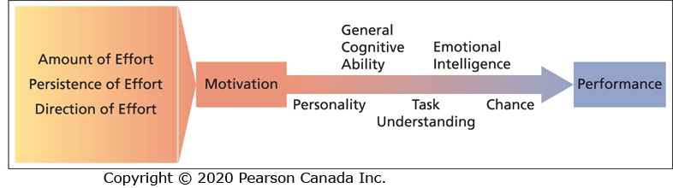
Factors Contributing to Individual Job Performance

Slide 19
General Cognitive Ability (1 of 2)
A person’s basic information-processing capacities and cognitive resources.
An individual’s overall capacity and efficiency to mentally process, understand, and learn information.
It includes a number of cognitive abilities (e.g., verbal, numerical, spatial) that are required to perform mental tasks.

Slide 20
General Cognitive Ability (2 of 2)
General cognitive ability predicts learning, training and career success, and job performance in all kinds of jobs and occupations.
It is an even better predictor of job performance for more complex and higher-level jobs.

Slide 21
Emotional Intelligence (EI) (1 of 2)
The ability to understand and manage one’s own and others’ feelings and emotions.
It involves the ability to:
  Perceive and express emotion.
  Assimilate emotion in thought.
  Understand and reason about emotions.
  Manage emotions in oneself and others.

Slide 22
Emotional Intelligence (EI) (2 of 2)
Peter Salovey and John Mayer developed an EI model that consists of four interrelated sets of skills or branches.
The four skills represent sequential steps that form a hierarchy:
  Perceiving emotions accurately in oneself and others.
  Using emotions to facilitate thinking.
  Understanding emotions, emotional language, and the signals conveyed by emotions.
  Managing emotions so as to attain specific goals.

Slide 23
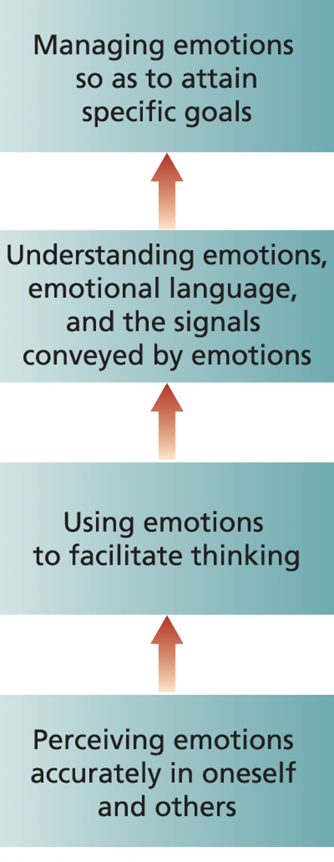
Four-Branch Model of Emotional Intelligence

Slide 24
Perceiving Emotions Accurately in Oneself and Others
The ability to perceive emotions and to accurately identify one’s own emotions and the emotions of others.
The ability to accurately identify emotions in people’s faces and in non-verbal behaviour.
The most basic level of EI; it is necessary to be able to perform the other steps in the model.

Slide 25
Using Emotions to Facilitate Thinking
The ability to use and assimilate emotions and emotional experiences to guide and facilitate one’s thinking and reasoning.
Using emotions in functional ways such as making decisions.

Slide 26
Understanding Emotions, Emotional Language, and the Signals Conveyed by Emotions
Involves being able to understand emotional information, the determinants and consequences of emotions, and how emotions evolve and change over time.
An understanding of how different situations and events generate emotions and how others are influenced by various emotions.

Slide 27
Managing Emotions to Attain Specific Goals
The ability to manage one’s own and others’ feeling and emotions as well as emotional relationships.
This is the highest level of EI and requires one to have mastered the previous stages.
The ability to regulate, adjust, and change one’s own emotions as well as others’ emotions to suit the situation.

Slide 28
Emotional Intelligence Research (1 of 2)
EI predicts performance in a number of areas including job performance and academic performance.
EI predicts job performance above and beyond cognitive ability and the Big Five personality dimensions.

Slide 29
Emotional Intelligence Research (2 of 2)
EI is most strongly related to job performance in jobs that require high levels of emotional labour.
EI has been found to be most important for the job performance of employees with lower levels of cognitive ability and of less importance for the job performance of employees with high levels of cognitive ability.

Slide 30
The Motivation-Performance Relationship (1 of 2)
It is possible for performance to be low even when a person is highly motivated.
In addition to personality, general cognitive ability, and EI, poor performance could also be due to:
  Poor understanding of the task.
  Luck and chance factors.

Slide 31
The Motivation-Performance Relationship (2 of 2)
We cannot consider motivation in isolation.
High motivation will not result in high performance if employees have low cognitive ability and EI, do not understand their jobs, or encounter unavoidable obstacles over which they have no control.
Motivational interventions will not work if employees are deficient in important skills and abilities.

Slide 32
Need Theories of Work Motivation (1 of 4)
Motivation theories that specify the kinds of needs people have and the conditions under which they will be motivated to satisfy these needs in a way that contributes to performance.

Slide 33
Need Theories of Work Motivation (2 of 4)
Needs are physiological and psychological wants or desires that can be satisfied by acquiring certain incentives or achieving particular goals.
It is the behaviour stimulated by this acquisition process that reveals the motivational character of needs:
NEEDS → BEHAVIOUR → INCENTIVES AND GOALS

Slide 34
Need Theories of Work Motivation (3 of 4)
Need theories are concerned with what motivates workers.
Process theories are concerned with exactly how various factors motivate people.
Need and process theories are complementary rather than contradictory.

Slide 35
Need Theories of Work Motivation (4 of 4)
Three prominent need theories of motivation:
  Maslow’s Hierarchy of Needs
  Alderfer’s ERG Theory
  McClelland’s Theory of Needs

Slide 36
Maslow’s Hierarchy of Needs (1 of 4)
A five-level hierarchical need theory of motivation that specifies that the lowest-level unsatisfied need has the greatest motivating potential. The needs include:
  Physiological needs
  Safety needs
  Belongingness needs
  Esteem needs
  Self-actualization needs

Slide 37
Physiological Needs
Needs that must be satisfied for the person to survive, such as food, water, oxygen, and shelter.
Organizational factors that might satisfy these needs include:
  Minimum pay necessary for survival
  Working conditions that promote existence

Slide 38
Safety Needs
Needs for security, stability, freedom from anxiety, and a structured and ordered environment.
Organizational conditions that might meet these needs include:
  Safe working conditions
  Fair and sensible rules and regulations
  Job security
  Comfortable work environment
  Pension and insurance plans
  Pay above the minimum standard

Slide 39
Belongingness Needs
Needs for social interaction, affection, love, companionship, and friendship.
Organizational factors that might meet these needs include:
  Opportunity to interact with others on the job
  Friendly and supportive supervision
  Opportunity for teamwork
  Opportunity to develop new social relationships

Slide 40
Esteem Needs
Needs for feelings of adequacy, competence, independence, strength, confidence, and the appreciation and recognition of these characteristics by others.
Organizational factors that might satisfy these needs include:
  Opportunity to master tasks leading to feelings of achievement and responsibility
  Awards, promotions, prestigious job titles, professional recognition

Slide 41
Self-Actualization Needs
These needs are difficult to define.
They involve the desire to develop one’s true potential as an individual to the fullest extent and to express one’s skills, talents, and emotions in a manner that is most personally fulfilling.
Organizational conditions that might provide self-actualization include absorbing jobs with the potential for creativity and growth.

Slide 42
Maslow’s Hierarchy of Needs (2 of 4)
What is the motivational premise of the theory?

Slide 43
Maslow’s Hierarchy of Needs (3 of 4)
The lowest-level unsatisfied need category has the greatest motivating potential.
When a need is unsatisfied, it exerts a powerful effect on the individual’s thinking and behaviour and is therefore motivational.
When needs at a particular level of the hierarchy are satisfied, the individual turns his or her attention to the next higher level.

Slide 44
Maslow’s Hierarchy of Needs (4 of 4)
A satisfied need is no longer an effective motivator.
The single exception involves self-actualization needs.
Self-actualization needs become stronger as they are gratified.

Slide 45
Alderfer’s ERG Theory (1 of 4)
Streamlines Maslow’s need classifications and makes some different assumptions about the relationship between needs and motivation.
A three-level hierarchical need theory of motivation (existence, relatedness, growth) that allows for movement up and down the hierarchy.

Slide 46
Existence Needs
Needs that are satisfied by some material substance or condition.
They correspond closely to Maslow’s physiological needs and to those safety needs that are satisfied by material conditions rather than interpersonal relations:
  Need for food, shelter, and pay
  Safe working conditions

Slide 47
Relatedness Needs
Needs that are satisfied by open communication and the exchange of thoughts and feelings with other organizational members.
They correspond closely to Maslow’s belongingness needs and to those esteem needs that involve feedback from others:
  Open, accurate, honest interaction rather than uncritical pleasantness
  Safe working conditions

Slide 48
Growth Needs
Needs that are fulfilled by strong personal involvement in the work setting.
They correspond to Maslow’s need for self-actualization and the aspects of esteem needs that concern achievement and responsibility:
  The full utilization of one’s skills and abilities
  The creative development of new skills and abilities

Slide 49
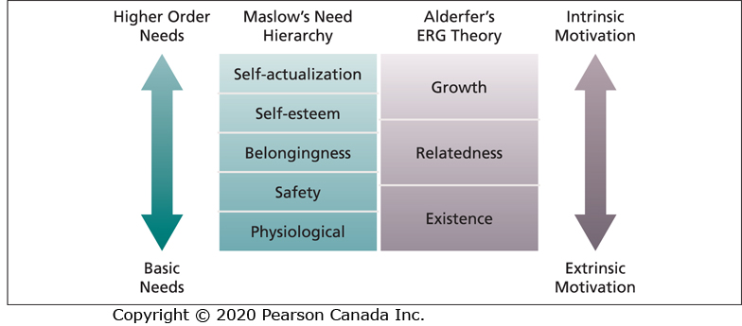
Relationship Between Maslow’s and Alderfer’s Need Theories

Slide 50
Alderfer’s ERG Theory (2 of 4)
Agreement with Maslow:
  As lower-level needs are satisfied, the desire to have higher-level needs satisfied will increase.
  The least concrete needs (growth needs) become more compelling and more desired as they are fulfilled.

Slide 51
Alderfer’s ERG Theory (3 of 4)
Differs from Maslow:
  Does not assume that a lower-level need must be gratified before a less concrete need becomes operative.
  If the higher-level needs are ungratified, individuals will increase their desire for the gratification of lower-level needs.

Slide 52
Alderfer’s ERG Theory (4 of 4)
Differs from Maslow:
  The frustration of higher-order needs will lead workers to regress to a more concrete need category.
  An apparently satisfied need can act as a motivator by substituting for an unsatisfied need.

Slide 53
Major Motivational Premises of ERG Theory
The more lower-level needs are gratified, the more higher-level need satisfaction is desired.
The less higher-level needs are gratified, the more lower-level need satisfaction is desired.

Slide 54
McClelland’s Theory of Needs (1 of 5)
A non-hierarchical need theory of motivation that outlines the conditions under which certain needs result in particular patterns of motivation.
Needs reflect relatively stable personality characteristics.

Slide 55
McClelland’s Theory of Needs (2 of 5)
Concerned with the specific behavioural consequences of three needs:
  Need for Achievement
  Need for Affiliation
  Need for Power

Slide 56
Need for Achievement
A strong desire to perform challenging tasks well.
Individuals with a high need for achievement exhibit the following characteristics:
  A preference for situations in which personal responsibility can be taken for outcomes.
  A tendency to set moderately difficult goals that provide for calculated risks.
  A desire for performance feedback.

Slide 57
Need for Affiliation
A strong desire to establish and maintain friendly, compatible interpersonal relationships.
People with a high need for affiliation have an ability to learn social networking quickly and a tendency to communicate frequently with others.
They prefer to avoid conflict and competition with others.

Slide 58
Need for Power
A strong desire to influence others, making a significant impact or impression.
People with a high need for power seek out social settings in which they can be influential.
Power can be used to serve the power seeker, other people, or the organization.

Slide 59
McClelland’s Theory of Needs (3 of 5)
McClelland predicts that people will be motivated to seek out and perform well in jobs that match their needs.

Slide 60
McClelland’s Theory of Needs (4 of 5)
People with high need for achievement:
  Sales jobs or entrepreneurial positions
People with high need for affiliation:
  Social work or customer relations
People with high need for power:
  Journalism and management

Slide 61
McClelland’s Theory of Needs (5 of 5)
The most effective managers have a low need for affiliation, a high need for power, and the ability to direct power toward organizational goals.

Slide 62
Research Support for Need Theories
(1 of 2)
Support for a simpler two-level need hierarchy comprising the needs toward the top and bottom of Maslow’s hierarchy.
Frustration of relatedness needs increases the strength of existence needs.
The simplicity and flexibility of ERG theory seems to capture the human need structure better than the greater complexity and rigidity of Maslow’s theory.

Slide 63
Research Support for Need Theories
(2 of 2)
Research on McClelland’s need theory is generally supportive of the idea that particular needs are motivational when the work setting permits the satisfaction of these needs.

Slide 64
Managerial Implications of Need Theories
Need theories have several implications for managerial attempts to motivate employees:
  Appreciate diversity
  Appreciate intrinsic motivation

Slide 65
Appreciate Diversity
Appreciate diversity of the needs of individual employees and offer incentives or goals that correspond to them.
Survey employees to find out what their needs are and then offer programs that meet their needs.

Slide 66
Appreciate Intrinsic Motivation (1 of 3)
Appreciate the motivational potential of intrinsic motivators and the existence of higher-order needs.
Avoid a vicious motivational cycle that relies on gratifying lower-level needs.
How can organizations benefit from the intrinsic motivation that is inherent in strong higher-order needs?

Slide 67
Appreciate Intrinsic Motivation (2 of 3)
Higher-order needs will fail to develop unless lower-level needs are reasonably well gratified.
If basic needs are met, jobs can be “enriched” to be more stimulating and challenging and to provide feelings of responsibility and achievement.

Slide 68
Appreciate Intrinsic Motivation (3 of 3)
Design career paths that enable interested workers to progress through a series of jobs that continue to challenge their higher-order needs.

Slide 69
Self-Determination Theory (SDT) (1 of 4)
Motivation depends on the satisfaction of three basic psychological needs:
  Competence
  Autonomy
  Relatedness
Needs are universal necessities for psychological health and well-being and they are not hierarchical.

Slide 70
Self-Determination Theory (SDT) (2 of 4)
Competence has to do with feeling a sense of mastery and being effective in one’s environment.
Relatedness has to do with feeling connected to others
Autonomy refers to having choice and feeling volitional in one’s behaviour.

Slide 71
Self-Determination Theory (SDT) (3 of 4)
SDT explains what motivates people and whether motivation is autonomous or controlled.
The focus is the quality rather than the quantity of motivation.
When people have their three basic needs satisfied, their motivation will be autonomous.
When these needs are not satisfied, motivation will be controlled.

Slide 72
Autonomous Motivation
Autonomous motivation is self-motivation or intrinsic motivation.
It occurs when people feel they are in control of their motivation.
When motivation is autonomous, individuals are performing a task because it is interesting and they have chosen to do it.
Motivation is internally rather than externally regulated.

Slide 73
Controlled Motivation
Controlled motivation occurs when people are motivated to obtain a desired consequence or extrinsic reward.
When motivation is controlled, individuals feel they are pressured and have no choice but to engage in a task.
Motivation is externally rather than internally regulated.

Slide 74
Self-Determination Theory (SDT) (4 of 4)
The basic premise of SDT is that work environments that lead to the satisfaction of the three psychological needs will promote autonomous motivation and lead to more effective performance and positive work outcomes.

Slide 75
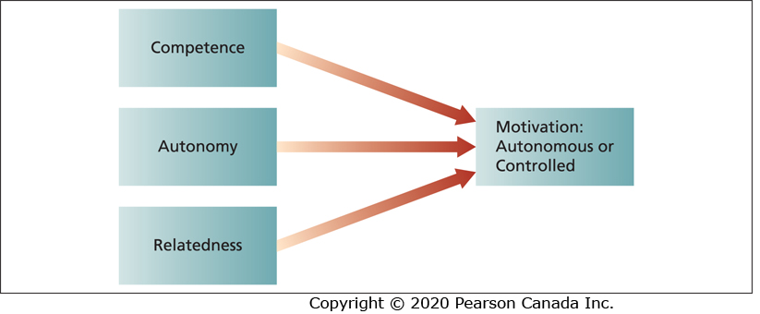
Self-Determination Theory

Slide 76
Research Support for SDT (1 of 3)
A key predictor of autonomous motivation is autonomy support from one’s supervisor.
Autonomy support involves providing employees with choice and encouragement for personal initiative.
Autonomy support is positively related to the satisfaction of the three basic psychological needs and autonomous motivation.

Slide 77
Research Support for SDT (2 of 3)
Satisfaction of the three psychological needs is positively related to job attitudes, work engagement, well-being, performance, and autonomous motivation.
Autonomous motivation is positively related to more effective job performance, especially on complex tasks.
Autonomous motivation is also related to more positive job attitudes and psychological well-being.

Slide 78
Research Support for SDT (3 of 3)
Controlled motivation is related to negative outcomes such as psychological distress and turnover intentions.

Slide 79
Managerial Implications of SDT
Create work environments that will satisfy employees’ basic psychological needs for competence, autonomy, and relatedness and facilitate autonomous motivation.
Managers should provide employees with autonomy support and jobs that are interesting and challenging and provide employees with some choice.
Interdependence among employees can also facilitate autonomous motivation.

Slide 80
Process Theories of Work Motivation
Motivation theories that specify the details of how motivation occurs.
Three important process theories:
  Expectancy theory
  Equity theory
  Goal setting theory

Slide 81
Expectancy Theory (1 of 2)
A process theory that states that motivation is determined by the outcomes that people expect to occur as a result of their actions on the job.
The basic components of Victor Vroom’s expectancy theory are:
  Outcomes
  Instrumentality
  Valence
  Expectancy
  Force

Slide 82
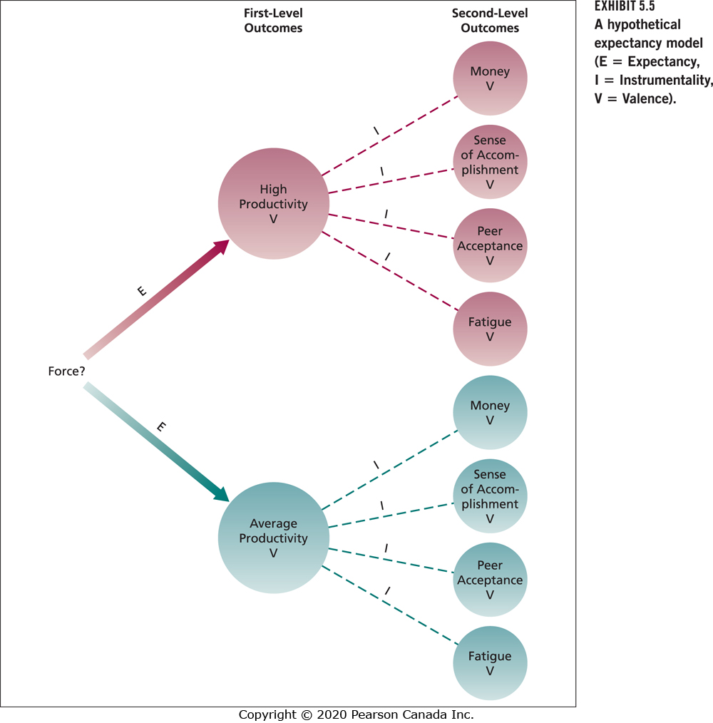
A Hypothetical Expectancy Model

Slide 83
Outcomes (1 of 2)
The consequences that may follow certain work behaviours.
First-level outcomes are of particular interest to the organization (e.g., high vs. average productivity).
Expectancy theory is concerned with specifying how an employee might attempt to choose one first-level outcome (e.g., high productivity) over another (e.g., average productivity).

Slide 84
Outcomes (2 of 2)
Second-level outcomes are consequences that follow the attainment of a particular first-level outcome.
They are of particular interest to the individual worker and involve things such as the amount of pay, sense of accomplishment, acceptance by peers, and so on.

Slide 85
Instrumentality (Performance → Outcome Link)
The probability that a particular first-level outcome (e.g., high productivity) will be followed by a particular second-level outcome (e.g., pay).
High productivity → 80% chance of a pay increase
Average productivity → 30% chance of a pay increase

Slide 86
Valence (1 of 2)
The expected value of outcomes, the extent to which they are attractive or unattractive to the individual.
The valence of first-level outcomes is the sum of products of the associated second-level outcomes and their instrumentalities:
the valence of particular first-level outcome = Σ instrumentalities × second-level valences

Slide 87
Valence (2 of 2)
The valence of a first-level outcome depends on the extent to which it leads to favourable second-level outcomes.

Slide 88
Expectancy (Effort → Performance Link)
The probability that the worker can actually achieve a particular first-level outcome.
→ High performance 50% certain
→ Average performance 100% certain

Slide 89
Force (1 of 2)
Force is the end product of the other components of the theory.
It represents the relative degree of effort that will be directed toward various first-level outcomes.

Slide 90
Force (2 of 2)
The force directed toward a first-level outcome is a product of the valence of that outcome and the expectancy that it can be achieved:
  force = first-level valence × expectancy
We can expect an individual’s effort to be directed toward the first-level outcome that has the largest force product.

Slide 91
The Premises of Expectancy Theory
People will be motivated to perform in those work activities that they find attractive and that they feel they can accomplish.
The attractiveness of various work activities depends on the extent to which they lead to favourable personal consequences.

Slide 92
Expectancy Theory (2 of 2)
Expectancy theory is based on the perceptions of the individual worker.
It can handle any form of second-level outcome that has relevance for the person in question (extrinsic and intrinsic outcomes).

Slide 93
Research Support for Expectancy Theory
Moderately favourable support for expectancy theory.
There is especially good evidence that the valence of first-level outcomes depends on the extent to which they lead to favourable second-level consequences.
Experts in motivation generally accept expectancy theory.

Slide 94
Managerial Implications of Expectancy Theory
The motivational implications of expectancy theory involve “juggling the numbers” that individuals attach to expectancies, instrumentalities, and valences.
Three implications:
  Boost expectancies
  Clarify reward contingencies
  Appreciate diverse needs

Slide 95
Boost Expectancies (1 of 2)
One of the most basic things managers can do is ensure that their employees expect to be able to achieve first-level outcomes that are of interest to the organization.
Workers will not pursue goals if expectancy is low.
Low expectancies can take many forms.

Slide 96
Reasons for Low Expectancies
Poor equipment, poor tools, lazy co-workers
Lack of understanding of what the organization considers good performance and how to achieve it.
Perception that performance evaluation ratings are capricious and arbitrary, and not understanding how to obtain a good rating.

Slide 97
Boost Expectancies (2 of 2)
Expectancies can usually be enhanced by:
  Providing proper equipment
  Training
  Demonstrating correct work procedures
  Explaining how performance is evaluated
  Listen to employee problems
The point is to clarify the path to beneficial first-level outcomes.

Slide 98
Clarify Reward Contingencies (1 of 2)
Managers should try to ensure that the paths between first- and second-level outcomes are clear.
Employees should be convinced that first-level outcomes are clearly instrumental in obtaining positive second-level outcomes and avoiding negative outcomes.

Slide 99
Clarify Reward Contingencies (2 of 2)
To ensure that instrumentalities are strongly established, they should be clearly stated and then acted on by the manager.
Managers should provide stimulating, challenging tasks for workers who are interested in such work.

Slide 100
Appreciate Diverse Needs
Managers should analyze the diverse preferences of employees and attempt to design individualized “motivational packages” to meet their needs.

Slide 101
Equity Theory (1 of 2)
Equity theory explains people’s job satisfaction through a comparison process of inputs and outcomes.
When workers’ perceive equity they experience job satisfaction; when they perceive inequity, they experience job dissatisfaction.
In what sense is equity theory a theory of motivation?

Slide 102
Equity Theory (2 of 2)
Motivation stems from a comparison of the inputs one invests in a job and the outcomes one receives in comparison with the inputs and outcomes of another person or group.
Individuals are motivated to maintain an equitable exchange relationship.
How do people reduce inequity and achieve equity?

Slide 103
Tactics for Reducing Inequity
Perceptually distort one’s own inputs or outcomes.
Perceptually distort the inputs or outcomes of the comparison person or group.
Choose another comparison person or group.
Alter one’s inputs or alter one’s outcomes.
Leave the exchange relationship

Slide 104
Equity Theory Example (1 of 5)
Terry is a middle manager in a consumer products company.
Terry’s inputs and outcomes:
  5 years work experience
  M.B.A. degree
  Good performance
  A salary of $75,000 a year

Slide 105
Equity Theory Example (2 of 5)
Terry learns that Maxine, a co-worker makes the same salary he does.
Maxine’s inputs and outcomes:
  1 year of work experience
  A Bachelor’s degree
  Average performance
What will Terry conclude when he compares his outcome/input ratio to Maxine’s and what might he do?

Slide 106
Equity Theory Example (3 of 5)
In Terry’s view, he is underpaid and should be experiencing inequity.
He might resolve this inequity psychologically or behaviourally.
He might try to increase his outcomes (seek a raise); reduce his inputs (a decrease in work effort); or resign.

Slide 107
Equity Theory Example (4 of 5)
If Maxine views the exchange relationship identically to Terry – same inputs and same outcomes - what will she be experiencing and what might she do?

Slide 108
Equity Theory Example (5 of 5)
Maxine will also experience inequity but from overpayment.
She might attempt to increase her inputs by working harder.
She might distort her view of Terry’s performance to make it seem closer to her own.
Equity theory is somewhat vague about when individuals will employ various inequity reduction strategies.

Slide 109
Gender and Equity
Both men and women tend to choose same-sex comparison persons.
This might provide a partial explanation for why women are paid less than men, even for the same job.

Slide 110
Research Support for Equity Theory
(1 of 2)
Research supports the theory when inequity occurs because of underpayment.
When workers are underpaid on an hourly basis, they tend to lower their inputs by producing less work.
When workers are underpaid on a piece-rate basis, they tend to produce a high volume of low-quality work.

Slide 111
Research Support for Equity Theory
(2 of 2)
Some evidence that underpayment inequity leads to resignation.
The theory’s predictions regarding overpayment inequity have received less support.
Suggests that people tolerate overpayment more than underpayment or they use perceptual distortion to reduce overpayment inequity.

Slide 112
Managerial Implications of Equity Theory (1 of 2)
Perceived underpayment will have a variety of negative motivational consequences for the organization (e.g., low productivity, low quality, theft).
Understand that feelings about equity stem from a perceptual social comparison process.
Understanding the role of comparison people is especially crucial.

Slide 113
Managerial Implications of Equity Theory (2 of 2)
Awareness of the comparison people chosen by workers might suggest strategies for reducing perceptions of inequity.

Slide 114
Goal Setting
A goal is the object or aim of an action.
Personal performance goals are vague or nonexistent for many organizational members.
Research has demonstrated when and how goal setting can be effective.

Slide 115
Goal Setting Theory
A process theory that states that goals are motivational when they are specific, challenging, and when organizational members are committed to them and feedback about progress toward goal attainment is provided.

Slide 116
What Kinds of Goals Are Motivational?
Goals are most motivational when they are:
  Specific
  Challenging
  Organizational members are committed to them
  Feedback about progress toward goal attainment is provided

Slide 117
Why Are Goals Motivational?
Four mechanisms explain why goals are motivational:
  They direct attention toward goal-relevant activities.
  They lead to greater effort.
  They increase and prolong persistence.
  They lead to the discovery and use of task-relevant strategies for goal attainment.

Slide 118
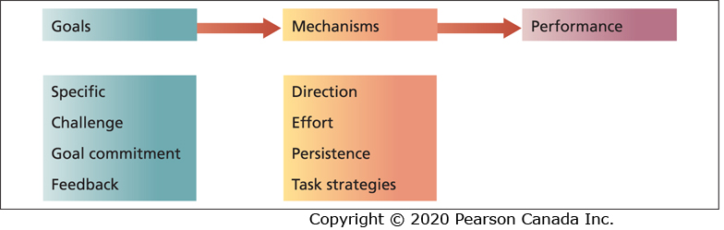
The Mechanisms of Goal Setting

Slide 119
Goal Specificity
Specific goals are goals that specify an exact level of achievement for people to accomplish in a particular time frame.
“I will enrol in five courses next semester and achieve a B or better in each course” is a specific goal.
“I will do my best” is not a specific goal since level of achievement and time frame are both vague.

Slide 120
Goal Challenge
Goals that are easy or impossible to achieve will not be motivational.
Goal challenge is a more personal matter than goal specificity.
Goal challenge is best when it is pegged to the competence of individual workers and increased as the particular task is mastered.
Base initial goals on past performance.

Slide 121
Goal Commitment
Individuals must be committed to specific, challenging goals if goals are to have effective motivational properties.
The effect of goals on performance is strongest when individuals have high goal commitment.
This is especially important when goals are challenging and difficult to achieve.

Slide 122
Goal Feedback
Specific and challenging goals are most effective when they are accompanied by ongoing feedback that enables the person to compare current performance with the goal.
To be most effective, feedback should be accurate, specific, credible, and timely.

Slide 123
Enhancing Goal Commitment
Factors that might affect commitment to challenging, specific goals:
  Participation
  Rewards
  Management support

Slide 124
Participation (1 of 3)
Sometimes participation in goal setting increases performance and sometimes it does not.
When will participation in goal setting improve performance?

Slide 125
Participation (2 of 3)
If goal commitment is a potential problem, participation might be beneficial.
Participation can improve goal commitment and facilitate performance in some situations:
  When a climate of distrust exists between management and employees.
  When participation provides information that assists in the establishment of fair, realistic goals.

Slide 126
Participation (3 of 3)
Research shows that participation can improve performance by increasing the difficulty of the goals that employees adopt.

Slide 127
Rewards
Goal setting has led to performance increases without the introduction of monetary incentives for goal accomplishment.
Goal setting should be compatible with any system that ties pay to performance that exists for the job in question.

Slide 128
Management Support
When supervisors behave in a coercive manner to encourage goal accomplishment, they can badly damage employee goal commitment.
Supervisors must demonstrate a desire to assist employees in goal accomplishment and behave supportively if failure occurs.
Threat and punishment in response to failure will be extremely counterproductive.

Slide 129
Goal Orientation (1 of 2)
Goal orientation refers to an individual’s goal preferences in achievement situations.
A stable individual difference that affects performance.
Three goal orientations:
  Learning goal orientation
  Performance-prove goal orientation
  Performance-avoid goal orientation

Slide 130
Learning Goal Orientation
A preference to learn new things and develop competence in an activity by acquiring new skills and mastering new situations.
A focus on acquiring new knowledge and skills and developing one’s competence.

Slide 131
Performance-Prove Goal Orientation
A preference to obtain favourable judgments about the outcome of one’s performance.

Slide 132
Performance-Avoid Goal Orientation
A preference to avoid negative judgments about the outcome of one’s performance.

Slide 133
Goal Orientation (2 of 2)
Goal orientation is important for learning and performance.
A learning goal orientation is positively related to learning as well as academic, task, and job performance.
A performance-avoid goal orientation is negatively related to learning and lower task and job performance.
A performance-prove goal orientation is not related to learning or performance outcomes.

Slide 134
Goal Proximity (1 of 2)
Goals can be distinguished in terms of whether they are distal or proximal goals.
A distal goal is a long-term or end-goal such as achieving a certain level of sales performance.
A proximal goal is a short-term or sub-goal that is instrumental for achieving a distal goal.

Slide 135
Goal Proximity (2 of 2)
Proximal goals are especially important for novel and complex tasks.
When distal goals are accompanied with proximal goals they have a significant positive effect on the discovery and use of task-relevant strategies, self-efficacy, and performance.

Slide 136
Research Support for Goal Setting Theory (1 of 3)
Research has demonstrated that specific, difficult goals lead to improved performance and productivity on a wide variety of tasks and occupations.
The effect of group goal setting on group performance is similar to the effect of individual goal setting.
The positive effects of goals persist over a long enough time to have practical value.

Slide 137
Research Support for Goal Setting Theory (2 of 3)
The effects of goal setting on performance depend on a number of factors.
When individuals lack the knowledge or skill to perform a novel or complex task, a specific and challenging performance goal can decrease performance.
When a task is straightforward, a specific, high performance goal results in higher performance.

Slide 138
Research Support for Goal Setting Theory (3 of 3)
A specific, high learning goal is more effective when individuals are learning to perform a novel or complex task.
There is also some evidence that subconscious goals have a positive effect on performance.
However, some research has found that in some situations there can be a dark side to goal setting.

Slide 139
Managerial Implications of Goal Setting Theory (1 of 2)
Managers should set specific and challenging goals and provide ongoing feedback to employees so they can compare their performance with the goal.
The performance impact of specific, challenging goals is stronger for simpler jobs than for more complex jobs.

Slide 140
Managerial Implications of Goal Setting Theory (2 of 2)
When a task is novel or complex and individuals need to acquire new knowledge and skills, setting a specific learning goal will be more effective than setting a high performance goal.
Proximal goals should be set in conjunction with distal goals when employees are learning a new task or performing a complex one.

Slide 141
Do Motivation Theories Translate Across Cultures? (1 of 4)
Are motivation theories culture-bound?

Slide 142
Do Motivation Theories Translate Across Cultures? (2 of 4)
Most theories that revolve around human needs will come up against cultural limitations to their generality.
Research has found support for self-determination theory across various cultures.
The satisfaction of the three basic psychological needs, autonomy support, and autonomous versus controlled motivation matters across cultures and organizational contexts.

Slide 143
Do Motivation Theories Translate Across Cultures? (3 of 4)
Equity theory will be constrained by what is considered “fair” in a particular culture in terms of how to allocate rewards (e.g., equity versus equality).
Because of its flexibility, expectancy theory is very effective when applied cross-culturally.
Setting specific and challenging goals should be motivational when applied cross-culturally.

Slide 144
Do Motivation Theories Translate Across Cultures? (4 of 4)
Goal setting has been found to predict, influence, and explain behaviour in many countries around the world.
The goal setting process must be adjusted to the culture (e.g., individual goals in individualistic cultures, group goals in collective cultures).
Cultural blinders often lead to motivational errors.
Appreciating cultural diversity is critical for maximizing motivation.

Slide 145
Integrating Theories of Work Motivation
Each of the theories of motivation helps us to understand a different part of the motivational process.
The different theories of motivation can be integrated to better understand work motivation and the relationship between job performance and job satisfaction.

Slide 146
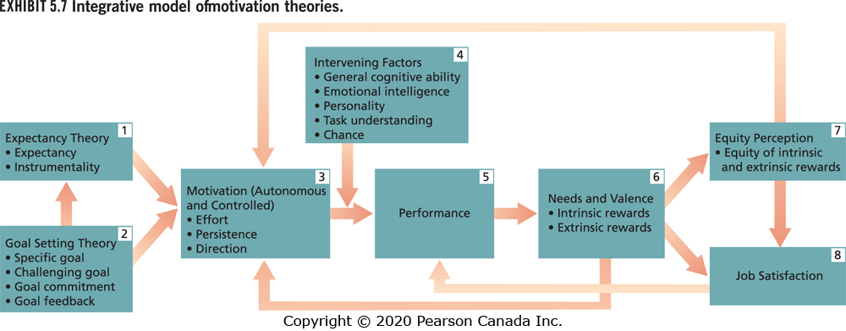
Integrative Model of Motivation Theories

